Slide 1
Cal Threshold Calibration and Monitoring Software Handbook
Zach Fewtrell
May 30, 2008

Slide 2
Calibration Overview
For each discriminator type, instrument acquires data @ 2 different settings, generally conservative and nominal
  for some discriminator types, special LAT configurations are required in order to isolate individual channel thresholds
thresholds are fit for each channel @ 2 configuration points
straight line is fit for each channel
linear models are merged into dacSlopes offline calibration XML file which stores linear slope / offset for all 4 Cal discriminator thresholds
LAC, FLE, FHE
  Calibration data taken with special asymmetric Cal configurations
ULD
  Use standard nomSciOps along with conSciOps data to fit straight line model.

Slide 3
Monitoring Overview
Thresholds may also be monitored from ‘standard’ nomSciOps or conSciOps data
  These configurations are not ideal for precise calibration, but are suitable for monitoring / trending instrument performance.

Slide 4
General Threshold calibration sequence
Fill Threshold Histograms
Inputs: digi ROOT files, TXT calib files
Outputs: ROOT file w/ histogram for each channel
Fit Threshold Histograms
Inputs: histogram ROOT file from ‘fill’ stage
Outputs:
ROOT file w/ fitted histogram for each channel,
ntuple with fit results,
TXT file with fit results
Fit DAC slopes
Inputs:
TXT files w/ fitted histograms for each DAC setting.
TXT file with associated DAC settings.
Outputs: TXT file with slope/offset parameters

Slide 5
Important File Formats
dacSlopes XML offline calibration file
  Contains linear model for all threshold discriminators in Cal (LAC,FLE,FHE,ULD)‏
LATC XML Param files
  Specify LAT configuration parameters including Cal discriminator DAC register settings.
TXT file formats
  Convention used internally by calibGenCAL C++ software.
Pedestal offline calibration file
  Used as input to threshold fitting programs.
muSlopes XML offline calibration file
  MISNAMED is really an adc2nrg file, also used as input to threshold fitting programs

Slide 6
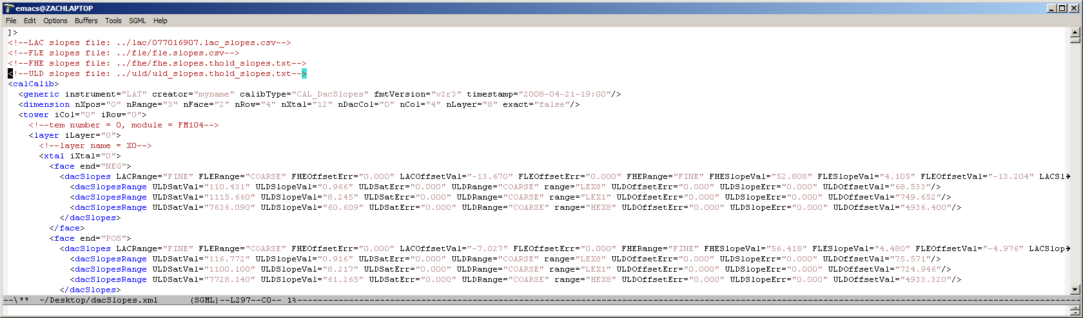
File Format 1: dacSlopes XML
Used as input to ConfigSystem LAT configuration generation tool.
  Note that all slopes (including ULD) are in MeV / discriminatorDAC units.
  RANGE fields specify fine (0-63) or coarse (64-127) discriminator DAC range.
  This file format only supports specification of one DAC range per channel

Slide 7
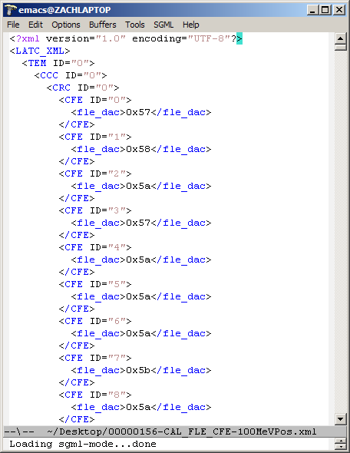
File Format 2: LATC XML

Slide 8
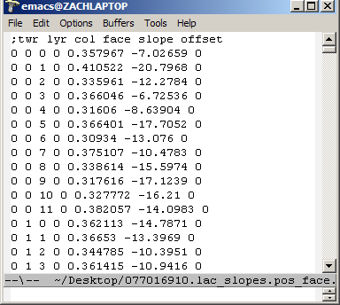
File Format 3: columnar TXT
For internal calibGenCAL use (we have no C++ XML read/write code, only python)‏
  Space delimited, semi-colon indicates comment/column names
  Will open natively in Excel / OpenOffice if you rename to *.csv
  Note offline Cal indexing scheme (POS_FACE = 0, layers in decreasing Z order)‏
  calibGenCAL has a full suite of xxxTXT2XML & xxxXML2TXT converter scripts.

Slide 9
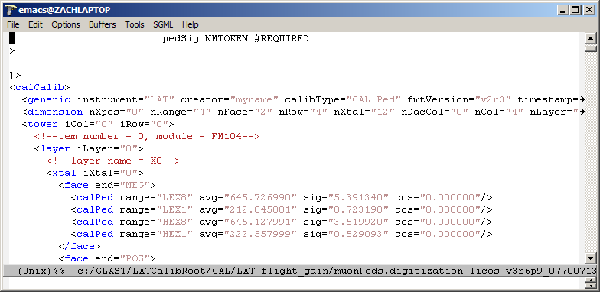
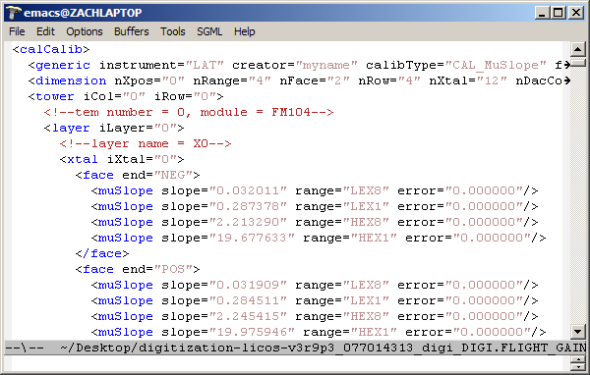
File Formats 4 & 5: muSlope / pedestal offline calib XML
Pedestal XML file
muSlopes (adc2nrg) XML file

Slide 10
Software Tools
Mostly available in calibGenCAL v5r5p2 (requested, but not yet included in GR)‏
  Some updates in soon-to-be-tagged v5r6p0
  Also CalUtil v3r12p2 required.
Threshold fitting
  LAC
    genLACHists.exe - fill threshold histograms from event data for LAC discriminator
    fitLACHists.exe - fit LAC threshold histograms for single LAT configuration
  FLE
    genFLEHists.exe - fill threshold histograms from event data for FLE discriminator
  FHE
    genFHEHists.exe - fill threshold histograms from event data for FHE discriminator
  ULD
    genULDHists.exe - fill threshold histograms from event data for ULD discriminator
    fitULDHists.exe - fit ULD threshold histograms for single LAT configuration
    fitULDSlopes.exe - find mev(uld_dac) linear model for all ULD discriminators in LAT
  Shared
    fitTrigHists.exe - fit FLE or FHE threshold histograms for single LAT configuration.
    fitThreshSlopes.exe - combine 2 LAT configurations and find linear model for each discriminator channel
    mergeDacSlopesXML.py - combine linear models for different discriminator types into single deliverable dacSlopes XML calibration file

Slide 11
Software Tools (monitoring)‏
Threshold Monitoring
  FLE/FHE
    genTrigMonitorHists.exe
    fitTrigMonitorHists.exe
  LAC
    TODO: Code written by Sasha, not yet included in calibGenCAL
  ULD
    Existing ULD calibration tools work on standard LPA configurations.

Slide 12
Software Tools (utilities)‏
pedXML2TXT.py, mpdXML2TXT.py
  Python scripts convert official XML calibration files into TXT files suitable for internal calibGenCAL usage.
dacSlopesDiff.py
  Compare 2 dacSlopes XML files, generate scatter plots, relative_diff histograms
sumHists.exe
  General purpose: sum all same-name histograms in ROOT files to new ROOT file
  Allows statistics from multiple analysis runs to be comibined.

Slide 13
calibGenCAL software environment
All calibGenCAL C++ executables & python scripts are available in PATH after CMT config.
All calibGenCAL exe & scripts output usage statement if executed with no commandline arguments.
All calibGenCAL python scripts have .sh (Linux) & .bat (Windows) launcher scripts which set up any needed environment variables.

Slide 14
Generate / Fit LAC Histograms
fewtrell@iris01 $ genLACHists.exe
Invalid commandline: Not enough required arguments, need 6
Usage: '../src/Thresh/genLACHists [options] faceName digiFilenames pedFilename muSlopeFilename outputBasename numEvents '
Where:
-h --help print usage info
faceName process either "POS_FACE" or "NEG_FACE" data
digiFilenames text file w/ newline delimited list of input digi ROOT files
pedFilename text file with pedestal calibration data
muSlopeFilename text file with muSlope (adc2mev) calibration data
outputBasename all output files will use this basename + some_ext
numEvents number of events to process
fewtrell@iris01 $ fitLACHists.exe
Invalid commandline: Not enough required arguments, need 3
Usage: '../src/Thresh/fitLACHists [options] histFilePath muSlopeFilename outputBasename '
Where:
-h --help print usage info
histFilePath ROOT histograms for each LAC threshold.
muSlopeFilename text file with muSlope (adc2mev) calibration data
outputBasename all output files will use this basename + some_ext

Slide 15
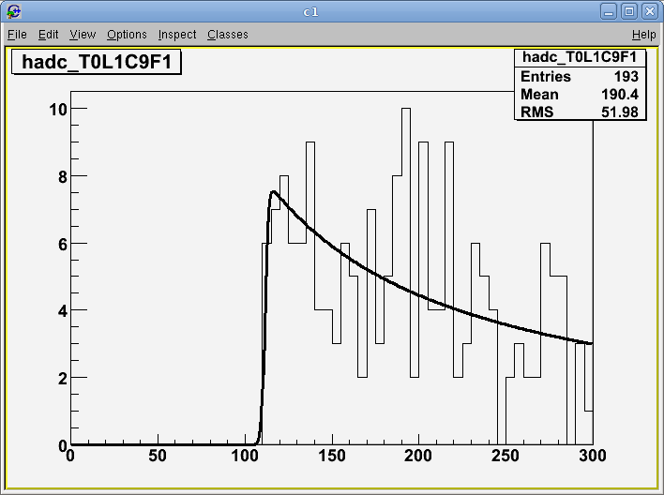
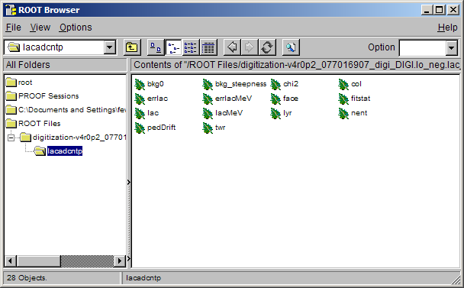
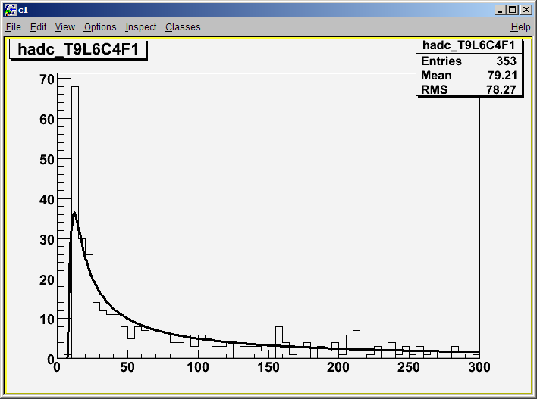
Fit LAC Histograms continued
4 MeV channel w/ 15 min ground muon collection (cold TVAC)‏
Tuple output contains fit results/quality info for each channel. (same for all Cal discriminators)‏
New in calibGenCAL v5r6p0, D. Sanchez new fitting method accounts for pedestal overlap w/ LAC threshold when temperature is poorly known.

Slide 16
Generate / Fit FLE / FHE Histograms
fewtrell@iris01 $ genFLEHists.exe
Invalid commandline: Not enough required arguments, need 7
Usage: '../src/Thresh/genFLEHists [options] faceName triggerPattern expectedThresh digiFilenames pedFilename muSlopeFilename outputBasename '
Where:
-h --help print usage info
-e --entriesPerHist quit after all histograms have > n entries
-s --safetyMargin select events with only 1 enabled crystal with signal above expectedThresh - safetyMargin (avoids misidentifying triggered crystals
faceName process either "POS" or "NEG" data
triggerPattern 'EREC' (even row (gcrc) even column) or 'EROC' (even row (gcrc) odd column
expectedThresh expected threshold in MeV
digiFilenames text file w/ newline delimited list of input digi ROOT files
pedFilename text file with pedestal calibration data
muSlopeFilename text file with muSlope (adc2mev) calibration data
outputBasename all output files will use this basename + some_ext
fewtrell@iris01 $ fitTrigHists.exe
Invalid commandline: Not enough required arguments, need 2
Usage: '../src/Thresh/fitTrigHists [options] histFilePath outputBasename '
Where:
-h --help print usage info
histFilePath ROOT trigger threshold histograms (output from genTrigHists)
outputBasename all output files will use this basename + some_ext
fewtrell@iris01 $

Slide 17
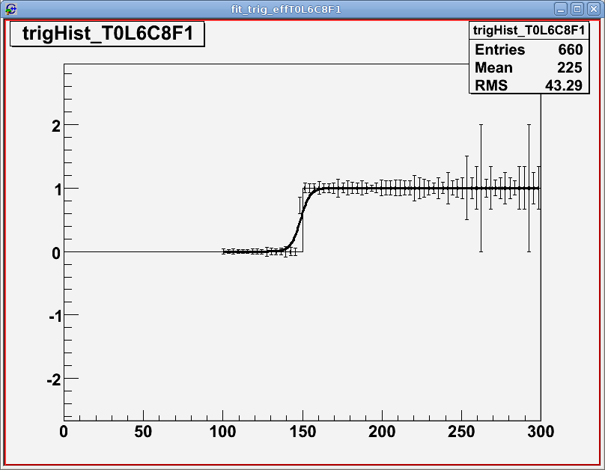
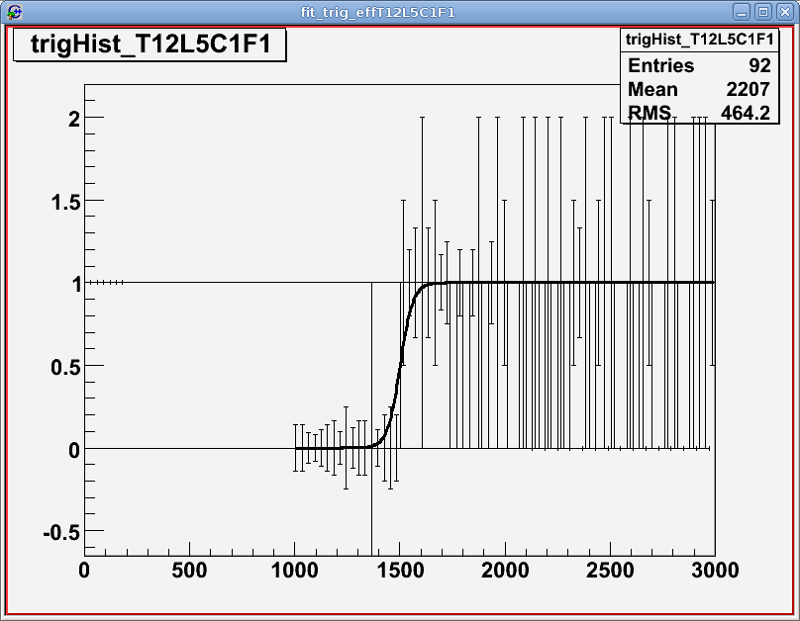
Fit FLE/FHE Histograms continued
fleCalib_evenHiNeg
X axis is MeV
y axis is fraction of events w/ trigger asserted.
X axis is MeV
y axis is fraction of events w/ trigger asserted.
X axis is MeV
y axis is fraction of events w/ trigger asserted.
1500 MeV w/ 30 min simulated collection
X axis is MeV
y axis is fraction of events w/ trigger asserted.

Slide 18
Fit Threshold Slopes (LAC,FLE,FHE)‏
fewtrell@iris01 $ fitThreshSlopes.exe
Invalid commandline: Not enough required arguments, need 5
Usage: '../src/Thresh/fitThreshSlopes [options] dac1Path thresh1Path dac2Path thresh2Path outputBasename '
Where:
-h --help print usage info
dac1Path pathname for dac settings for 1st fitted point
thresh1Path pathname for energy thresholds for 1st fitted point
dac2Path pathname for dac settings for 2nd fitted point
thresh2Path pathname for energy thresholds for 2nd fitted point
outputBasename all output files will use this basename + some_ext

Slide 19
Generate / Fit ULD Histograms
fewtrell@iris01 $ genULDHists.exe
Invalid commandline: Not enough required arguments, need 3
Usage: '../src/Thresh/genULDHists [options] digiFilenames outputBasename numEvents '
Where:
-h --help print usage info
digiFilenames text file w/ newline delimited list of input digi ROOT files
outputBasename all output files will use this basename + some_ext
numEvents number of events to process
fewtrell@iris01 $ fitULDHists.exe
Invalid commandline: Not enough required arguments, need 2
Usage: '../src/Thresh/fitULDHists [options] histFilePath outputBasename '
Where:
-h --help print usage info
histFilePath ROOT histograms for each ULD threshold.
outputBasename all output files will use this basename + some_ext
fewtrell@iris01 $ fitULDSlopes.exe
Invalid commandline: Not enough required arguments, need 7
Usage: '../src/Thresh/fitULDSlopes [options] pedFilename muSlopeFilename dac1Path thresh1Path dac2Path thresh2Path outputBasename '
Where:
-h --help print usage info
pedFilename text file with pedestal calibration data
muSlopeFilename text file with muSlope (adc2mev) calibration data
dac1Path pathname for dac settings for 1st fitted point
thresh1Path pathname for energy thresholds for 1st fitted point
dac2Path pathname for dac settings for 2nd fitted point
thresh2Path pathname for energy thresholds for 2nd fitted point
outputBasename all output files will use this basename + some_ext

Slide 20
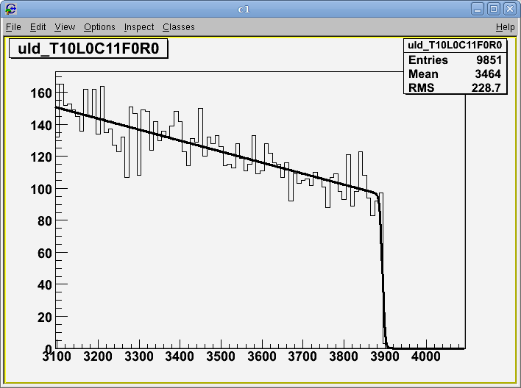
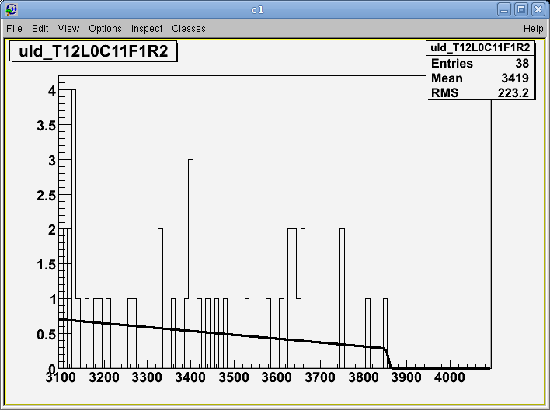
Fit ULD_DAC Slopes continued
LEX8 channel
worst case (HEX1) channel w/ lowest statistics in 11 hour nomSciOps sim

Slide 21
Generate dacSlopes XML
fewtrell@iris01 $ mergeDacSlopes.sh
ERROR:mergeDacSlopes:
Tool to produce CAL DAC XML calibration data file from TXT files for each discriminator type
mergeDacSlopes [-V] [-L <log_file>] [-doptionaldtd] <lac_slopes_txt> <fle_slopes_txt> <fhe_slopes_txt> <uld_slopes_txt> <output_xml>
where:
-V = verbose; turn on debug output
-L <log_file> = save console output to log text file
-d = specify path to optional dtd file
<lac_slopes_txt> = path to input lac slopes file
<fle_slopes_txt> = path to input fle slopes file
<fhe_slopes_txt> = path to input fhe slopes file
<uld_slopes_txt> = path to input uld slopes file
<output_xml> = output xml path
INPUTS:
LAC, FLE, FHE:
Slopes are expressed in MeV/DAC unit.
TXT file columns are space delimited, ';' in 1st character on line indicates comment
All Cal component indexing uses GLAST offline software conventions (POS_FACE = 0, layers numberd 0-7 along LAT z axis in direction away from tracker.)‏
TXT format is as follows:
"tower layer column face slope slope_error dac_range"
where for dac_range, 0 = FINE and 1 = COARSE
ULD:
Slopes are expressed in MeV/DAC unit.
TXT file columns are space delimited, ';' in 1st character on line indicates comment
All Cal component indexing uses GLAST offline software conventions (POS_FACE = 0, layers numberd 0-7 along LAT z axis in direction away from tracker.)‏
TXT format is as follows:
"tower layer column face adc_range slope slope_error dac_range saturation_mev"
where for dac_range, 0 = FINE and 1 = COARSE
OUTPUTS:
one offline Cal dacSlopes XML file.

Slide 22
Monitor FLE/FHE trigger performance
fewtrell@iris01 $ genTrigMonitorHists.exe
Invalid commandline: Not enough required arguments, need 4
Usage: '../src/Thresh/genTrigMonitorHists [options] digiFilenames pedFilename muSlopeFilename outputBasename '
Where:
-h --help print usage info
digiFilenames text file w/ newline delimited list of input digi ROOT files
pedFilename text file with pedestal calibration data
muSlopeFilename text file with muSlope (adc2mev) calibration data
outputBasename all output files will use this basename + some_ext
fewtrell@iris01 $ fitTrigMonitorHists.exe
Invalid commandline: Not enough required arguments, need 2
Usage: '../src/Thresh/fitTrigMonitorHists [options] histFilePath outputBasename '
Where:
-h --help print usage info
histFilePath ROOT trigger threshold histograms (output from genTrigHists)
outputBasename all output files will use this basename + some_ext

Slide 23
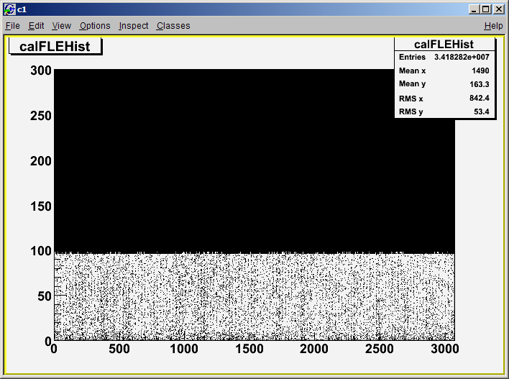
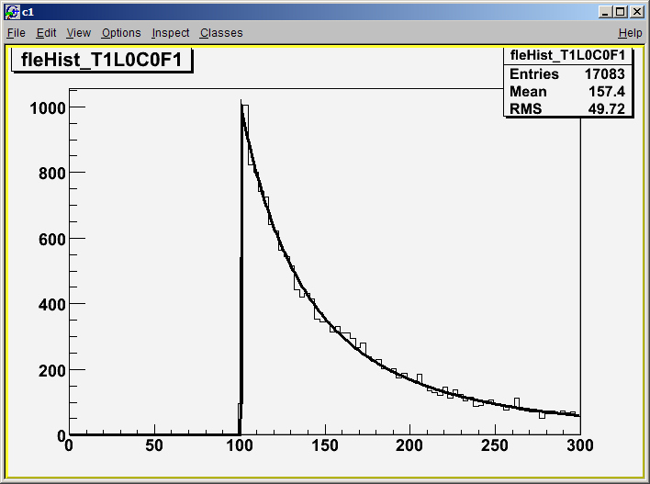
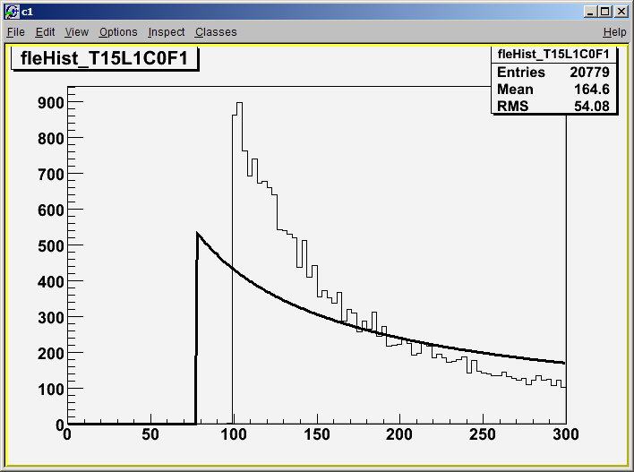
Monitor FLE/FHE continued
FLE threshold fit from nomSciOps simulated data
X=channel_id, y=mev
Cal wide trigger plot can summarize overall trigger response with relatively low statistics.
Note: Noise below trigger threshold may be result of diode deposits saturating large diode only (causing a low energy HE best range readout).
TODO: my step*power_law fitting function doesn’t always find the threshold properly

Slide 24
Software Utilities
fewtrell@iris01 $ pedXML2TXT.sh
no input file specified:
Dump GLAST Cal offline pedestal calibration xml into column delmited text on stdout
output format is:
twr lyr col face range pedestal sigma
pedXML2TXT [-d delim] <input_xml_file>
where:
<input_xml_file> = input pedestal GLAST Cal offline calibration file
-d delim = optional field delimeter override (default = ' ')‏
fewtrell@iris01 $ muSlopeXML2TXT.sh
no input file specified:
Dump GLAST Cal offline muSlope calibration xml into column delmited text on stdout
output format is:
twr lyr col face range muSlope error
muSlopeXML2TXT [-d delim] <input_xml_file>
where:
<input_xml_file> = input muSlope GLAST Cal offline calibration file
-d delim = optional field delimeter override (default = ' ')‏
fewtrell@iris01 $ sumHists.exe
Not enough paramters:
sumHists.cxx outputPath.root [inputPath.root]+
where:
outputPath.root = output ROOT file
inputPath.root = 0 or more input ROOT files (input files may also be specified by newline delimited list to STDIN)‏
fewtrell@iris01 $ dacSlopesDiff.sh
ERROR:dacSlopesDiff:bad n args: 0
Diff 2 CAL dacSlopes offline calibration XML files (generate useful ROOT plots). The command line is:
python dacSlopesDiff.py <dacSlopes_xml_file1> <dacSlopes_xml_file2> <output_basename>
where:
<dacSlopes_xml_file1> = GLAST Cal dacSlopes offline calib file
<dacSlopes_xml_file2> = GLAST Cal dacSlopes offline calib file
<output_basename> = base filename for all output files

Slide 25
More Utility Software
dacSlopesPlot.py
  visualize single dac slopes file.

Slide 26
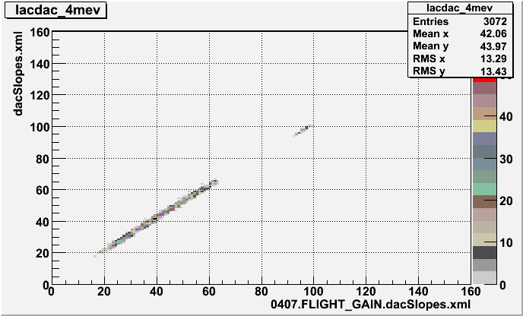
Software Utilties continued
Sample dacSlopesDiff output
LPA calibrated setting (cold TVAC) vs LCI calibrated setting (room temperature).
Note the 2 populations, FINE & COARSE range DAC settings.
Note the drift in DAC settings caused by temperature change.

Slide 27
Available Data
LAC
  Cold TVAC data collections: 077016907, 908,910,911
FLE/FHE
  A. Makeev’s simulated data for each configuration stored @ SLAC: /nfs/farm/g/glast/u33/makeev/cal_config . (statistics lower than anticipated for actual flight calib)‏
ULD
  MC Simulated nomSciOps & conSciOps backgrounds available via Glast Data Portal

Slide 28
Other references
CAL-17 JIRA
  Request to include Threshold calibration code in GlastRelease.
D. Sanchez LAC presentation improving LAC fits w/ overlapping pedestal Gaussians.
  http://confluence.slac.stanford.edu/download/attachments/14876941/Lac.pdf

Slide 29
Addendum: Pedestal Calibration / Trending
genMuonPeds.exe
  Fill & fit Cal pedestal histograms from Digi data, periodic trigger by default.
  misnomer: Not specific to 'muon' data collections, fine for flight data.
pedDiff.py
  plot changes from one pedestal file to another, calibGenCAL currently supports comparing 2 files as opposed to trending > 2 files.
pedVal.py
  Plot pedestal & sigma distributions for single pedestal calibration file

Slide 30
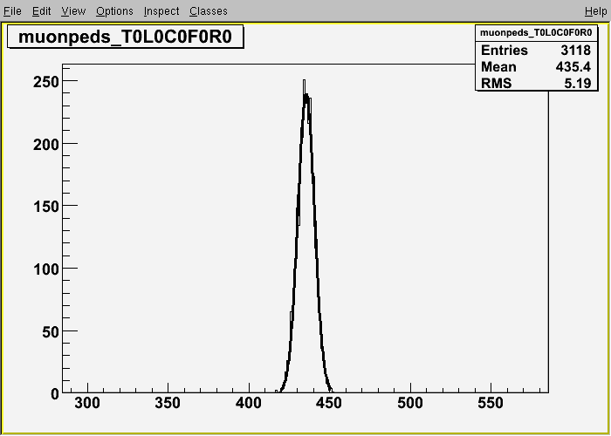
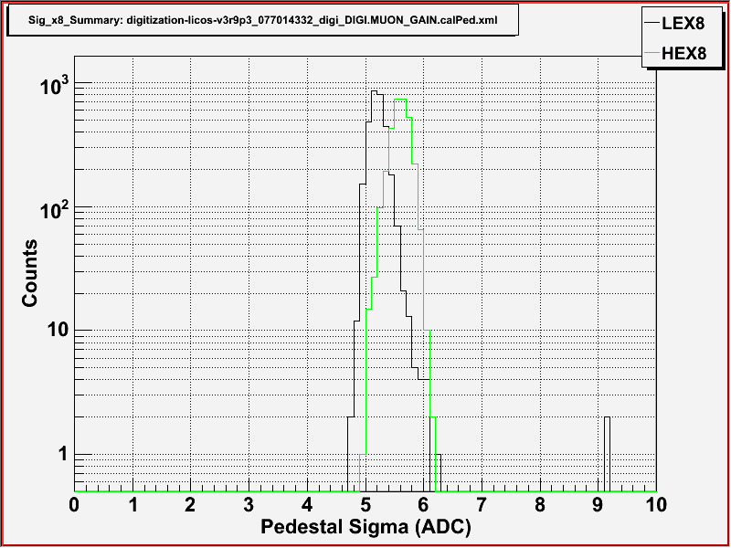
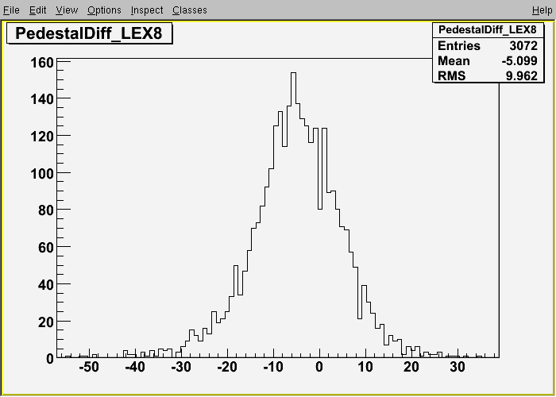
Pedestal Calib continued
genMuonPed.exe output:
Sample fitted LEX8 pedestal distribution
pedVal.py output:
Cal wide distibution of LEX8/HEX8 pedestal widths
pedDiff.py output:
Pedestal peak drift due to temperature change between room & cold TVAC

